Slide 1
File Handling

Slide 2
C++ I/O Features
C++ defines its own object-oriented I/O system.
C++ I/O system supplies consistent interface to the programmer independent of actual device.
A stream is a logical device that produces or consumes information.
Two types of streams:
Text stream which is a sequence of characters.
Binary stream which is a sequence of bytes, no character translation.

Slide 3
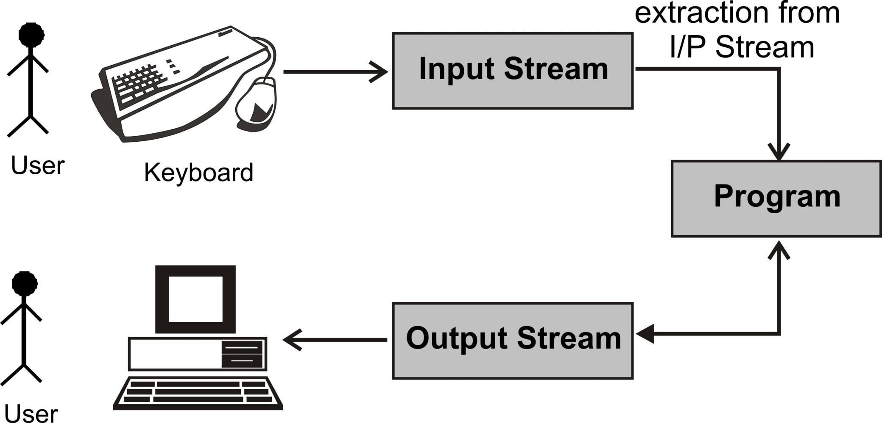
Data Stream

Slide 4
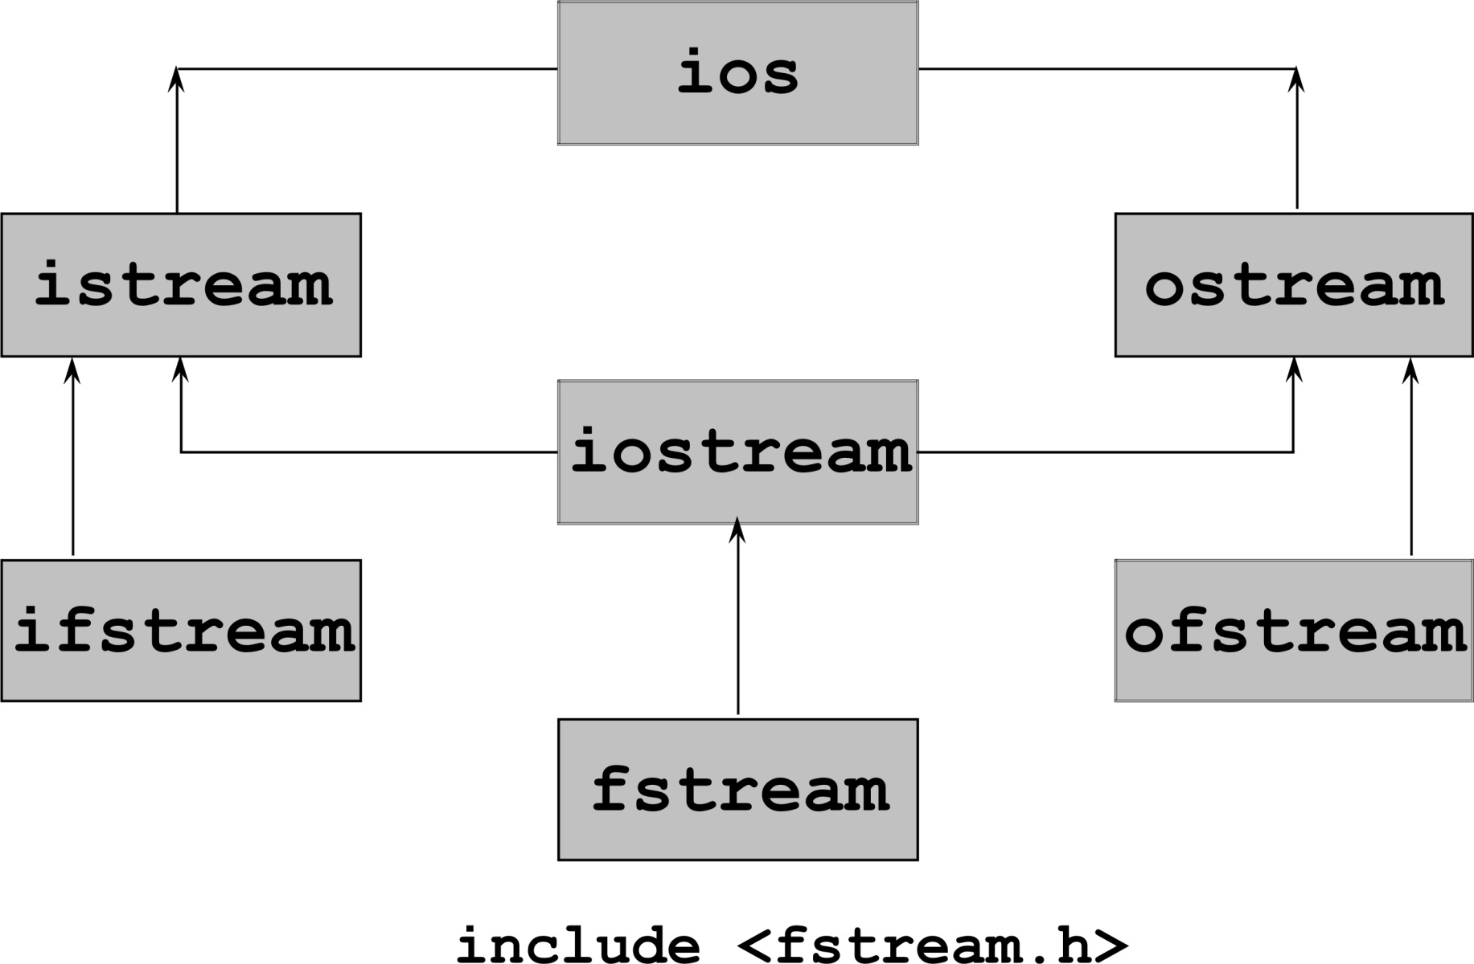
Stream Class for File I/O

Slide 5
File Operations
Different file operations that can be performed through a C++ program -
1. Open a file
2a. Read a file
Or
2b. Write a file
3. Close a file

Slide 6
Opening a File
File can be opened in two ways
Using constructor function of a class
Using function open()
ofstream outfile(“result”);
outfile.open(“result”);

Slide 7
Using Constructor to Open a File
Facilitates file operations
#include<fstream>
using namespace std;
int main()
{
ofstream outfile(“result”);
...
outfile.close();
return 0;
}
outfile is an object of class ofstream
Constructor will open file in write mode
Closes file
When file object goes out of scope, corresponding destructor is called which closes the file.

Slide 8
Using open() to Open File
open() associates the file stream with the file.
open() is a member function of ofstream, ifstream and fstream classes.
void ifstream::open(char* filename,mode=ios::in);
void ofstream::open(char* filename,mode=ios::out|
ios::trunc );
void fstream::open(char* filename,mode=ios::in |
ios::out);

Slide 9
Write data into file
ofstream myfile;
myfile.open(name);
if(myfile.fail())
{
cout<<"not open"<<endl;
}
else
{ string data=" this is my data to write";
myfile<<data;
myfile.close();
cout<<"data written "<<endl;
}

Slide 10
//read data
ifstream myfile;
myfile.open(name);
if(myfile.fail())
cout<<" not open "<<endl;
else
{
cout<<"open for read "<<endl;
string filetext;
while(getline(myfile,filetext))
{
cout<<filetext;
}
myfile.close();
}

Slide 11
Types of File Opening Modes
Parameter | Meaning
ios::app | Append to end of file
ios::binary | Binary file.
ios::in | Open file for reading only (default arg).
ios::nocreate | Open fails if the file does not exist.
ios::noreplace | Open fails if the file already exists.
ios::out | Open file for writing only (default arg).
ios::trunc | Causes contents of pre-existing with same file name to be destroyed.

Slide 12
Operators << and >> to Handle Files
To read from or write to a text file, the << and >> operators are used like console I/O.
Instead of using cin and cout, the stream that is linked to a file is used.
ofstream out(“myfile”);
out<<“Hello World”;
...
out.close();
ifstream in;
in.open(“myfile”);
char str[50];
in>>str;
cout<<str;
Writes to output file -myfile
Close the file before opening in other mode
Reads from input file - myfile

Slide 13
fstream out(name,ios::out);
cout<<" enter text "<<endl;
string text;
cin>>text;
//write text in file
out<<text;
cout<<"data written "<<endl;
out.close();
char data[100];
fstream in(name,ios::in);
in>>data;
cout<<data<<endl;
in.close();

Slide 14
Handling Files – Character-based Functions
A pair of functions put() and get() is used to access a file character by character.
get(char) will read a character.
put(char) will write a character.
//writes A to Z characters to file
for(int i=65;i<91;i++)
out.put((char)i);
………….
//Reads 1 character at a time till
end-of-file
while(in)
{
in.get(ch);
if(in) cout<<ch;
}
Object of ofstream
Object of ifstream

Slide 15
fstream myfile;
myfile.open(name,ios::out);
for(int i=65;i<91;i++)
{
myfile.put((char)i);
}
cout<<"data written "<<endl;
cout<<"now reading from file "<<endl;
myfile.close();
char ch;
fstream myread(name,ios::in);
while(myread)
{
myread.get(ch);
cout<<ch;
}
myread.close();

Slide 16
Handling Files – String-based Functions
A pair of functions write() and read() are used to access the file in binary mode.
istream &read(char *buf, long num);
ostream &write(const char *buf, long num);
class CStudent {
int roll_no;
char name[30];
char grade;
public:
void accept();
void display();
};
CStudent S1,S2;
S1.accept();
out.write((char*)&S1,sizeof(CStudent);
...
in.read((char*)&S2,sizeof(CStudent));
S2.display();
...

Slide 17
Random Access in Files
Random access is achieved using seekg() and seekp() functions.
seekg()/seekp() moves get/put pointer offset number of characters from the specified origin.
origin must be one of the three values:
ios::beg Beginning-of-file
ios::cur Current location
ios::end End-of-file
istream::seekg(offset,origin)
ostream::seekp(offset,origin)

